Slide 1
WELCOME TO OUR
SERVICE

Slide 2
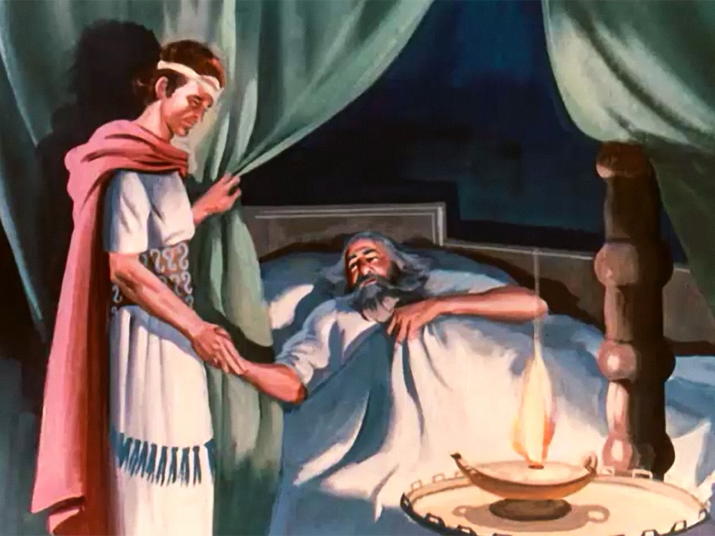
1. A WISE KING who KNOWS GOD
Solomon showed his love for the LORD by walking according to the instructions given him by his father David.
1 Kings 3:3

Slide 3
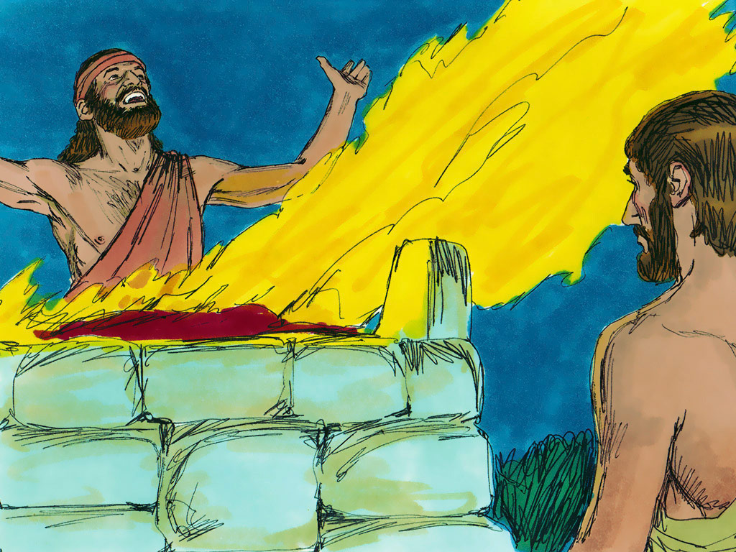
1. A WISE KING who KNOWS GOD
EXCEPT THAT he offered sacrifices and burned incense on the high places.
1 Kings 3:3

Slide 4
Prayer from Psalm 143:10 (GNB)
You are my God;
Teach me to do your will.
Be good to me,
And guide me on a straight path.
Amen.

Slide 5
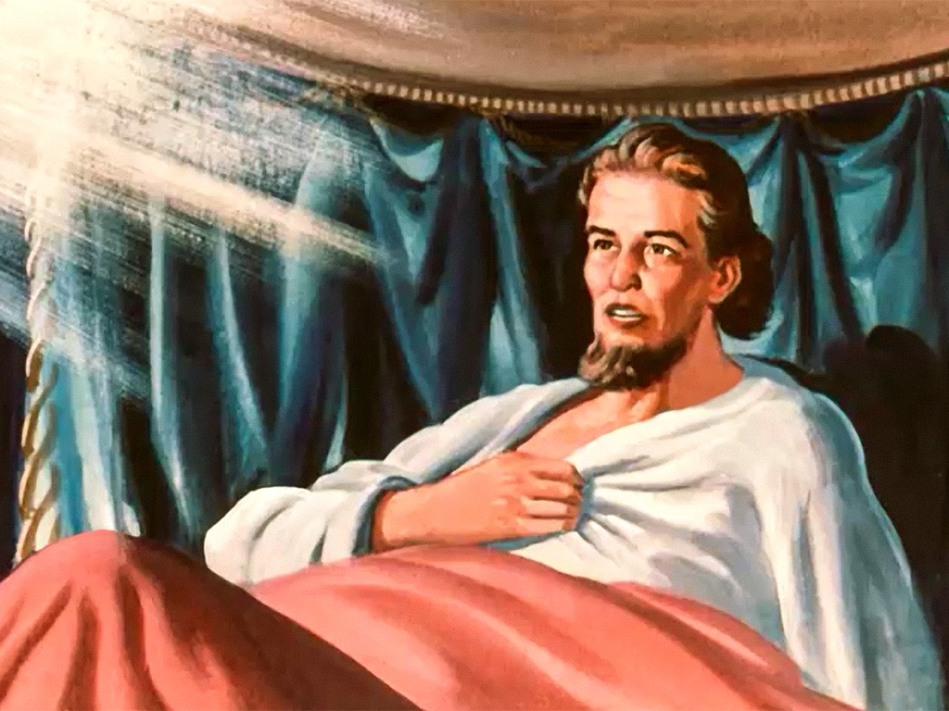
2. A WISE KING who KNOWS HIMSELF
…the LORD appeared to Solomon during the night in a dream, and God said, ‘Ask for whatever you want me to give you.’
1 Kings 3:5

Slide 6
2. A WISE KING who KNOWS HIMSELF
Solomon knew who he was –
A young king
Solomon knew who he was –
God’s servant, with God as King
Solomon knew who he was –
A child, who needed help

Slide 7
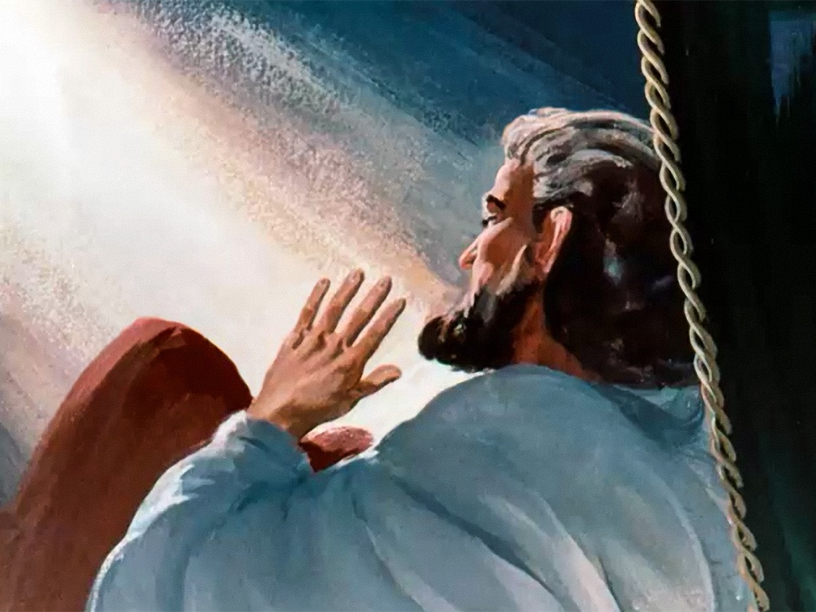
2. A WISE KING who KNOWS HIMSELF
I want to be wise! I want to know how to tell wrong from right.
1 Kings 3:9

Slide 8
2. A WISE KING who KNOWS HIMSELF
Ask for whatever you want me to give you!
1 Kings 3:5

Slide 9
3. A WISE KING who PLEASES GOD
The Lord was pleased that Solomon had asked for wisdom.
1 Kings 3:10

Slide 10
3. A WISE KING who PLEASES GOD
What is wisdom?
Wisdom begins with respect for the Lord. And understanding begins with knowing God, the Holy One. Proverbs 9:10 (International Children’s Bible)

Slide 11
3. A WISE KING who PLEASES GOD
What is wisdom?
Wisdom begins with knowing God and realising HE is God and we are not.

